Slide 1
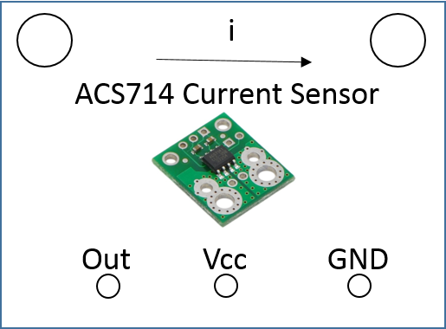
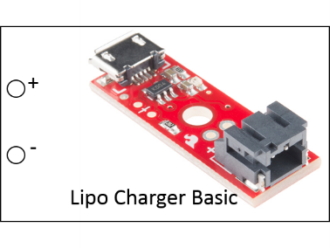
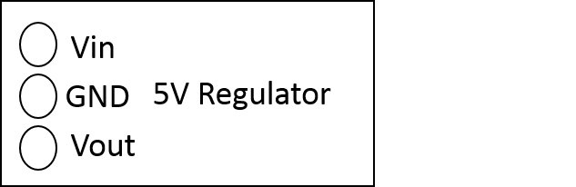
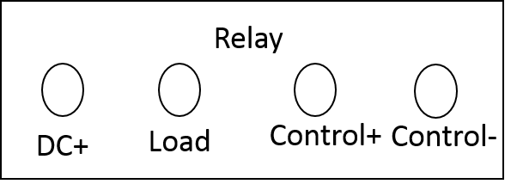
Bat 3.7-4.2V
Due Vin
Due I/O Pin
Due 5V
Due Control Pin
5V High current line
Batt GND
Due GND

Slide 2
QuadBot Board
Bat 3.7-4.2V
Due Vin
Due I/O Pin
Due 5V
Due Control Pin
5V High current line
Batt GND
Due GND

Slide 3
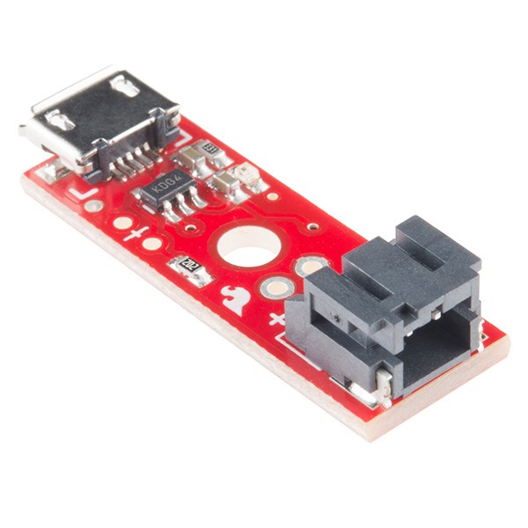
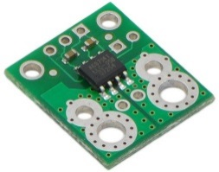
Vin
WW
GND
Vout
+
-
Lipo Charger Basic
i
Relay
ACS714 Current Sensor
DC+
Load
Control+
Control-
Out
Vcc
GND

Slide 4
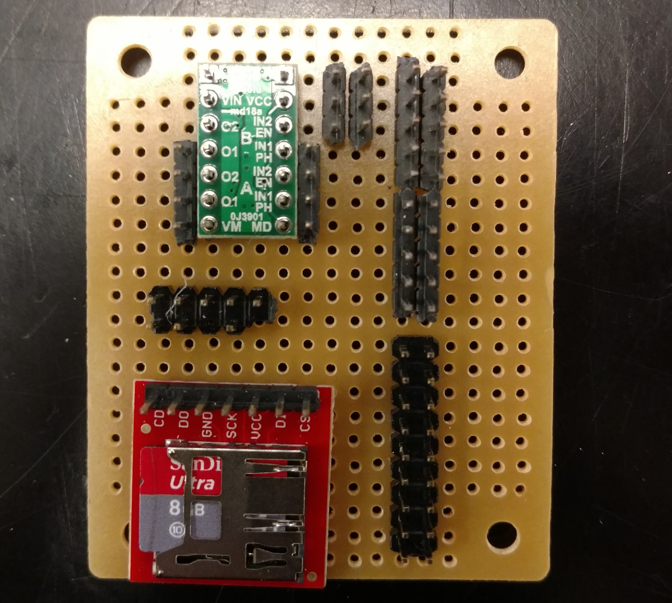
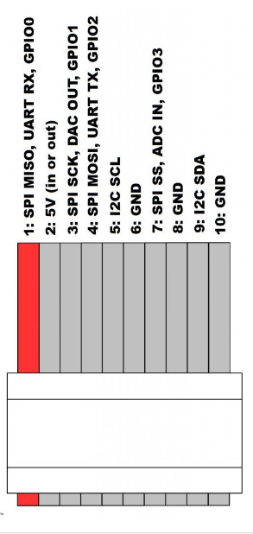
5V High Current
GND Due
GND
5V Due
3.3V Due
Due Pin 4

Slide 5
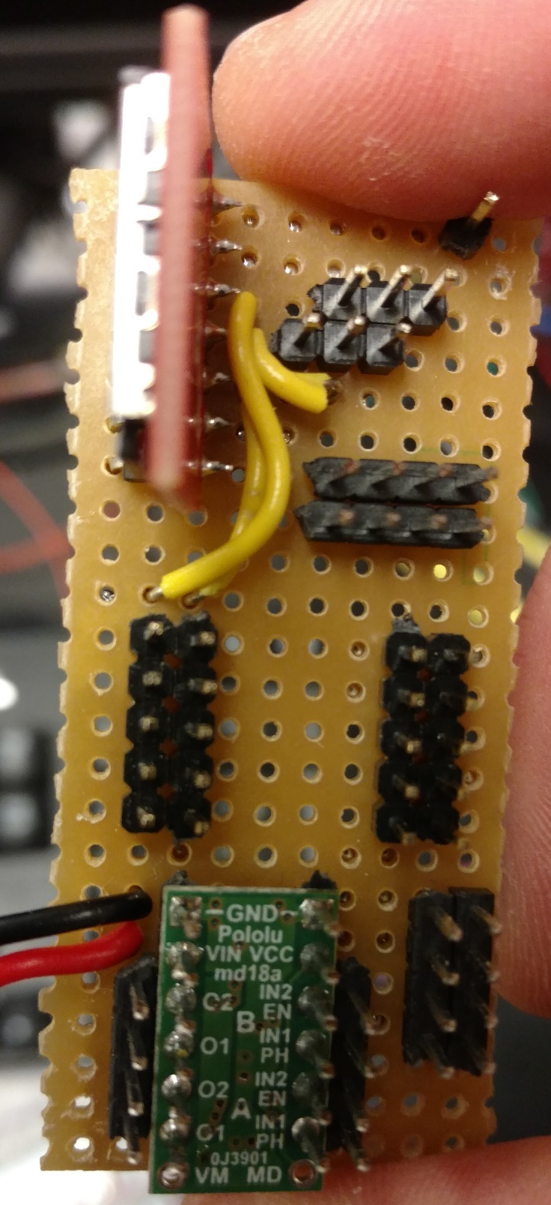
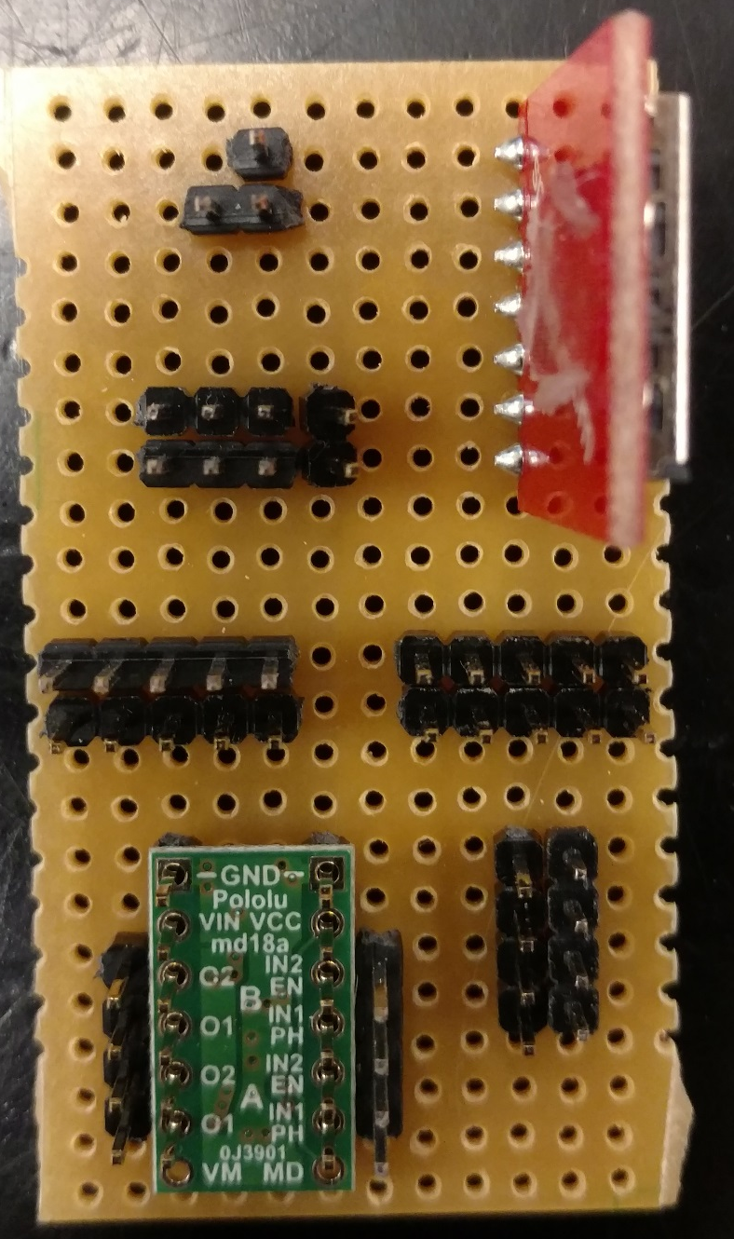
1 2
3 4
5 6
7 8
9 10
SPI Ribbon - Chip Reader:
1 – D0
3 – SCK
4 – D1

Slide 6
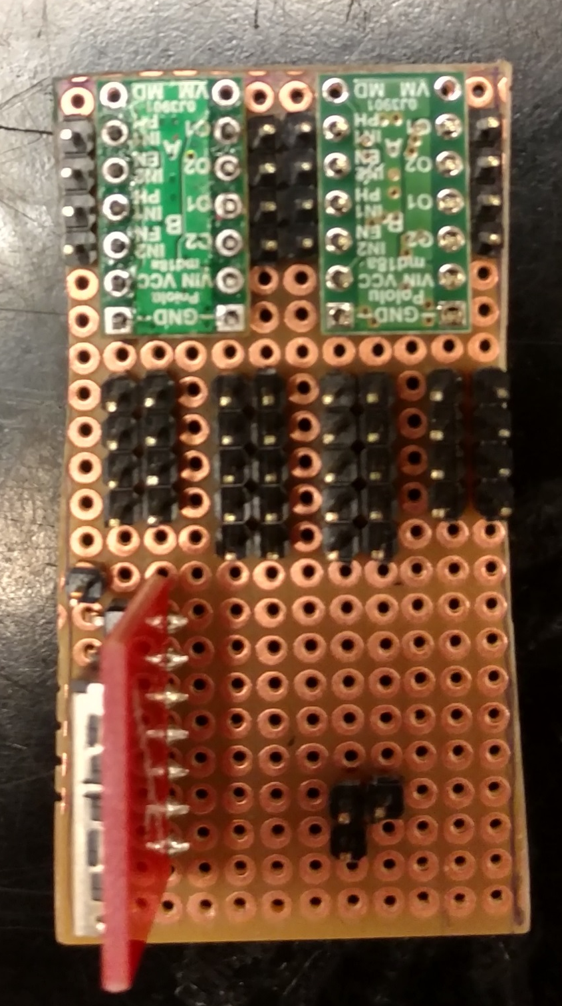
MB2
MB1
BATT+
BATT GND
SCL/SDA Lines
5V Reg +
5V Reg GND
Due 5V+
Due GND
Due GND
Due 3V+

Slide 7
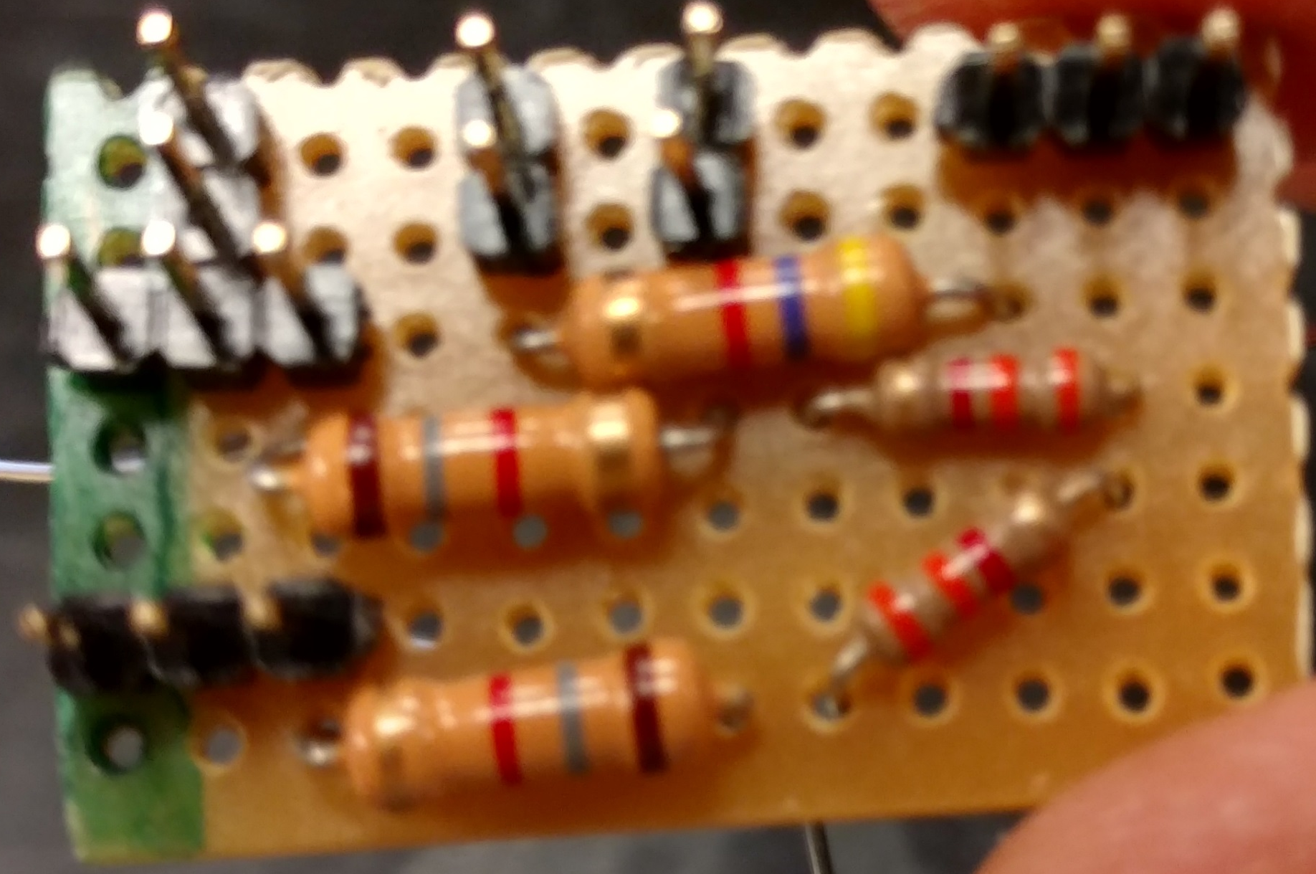
FSR, Hall Effect Sensors, and Charging Rod Detector Circuit
Due 5V+
Due GND

Slide 8
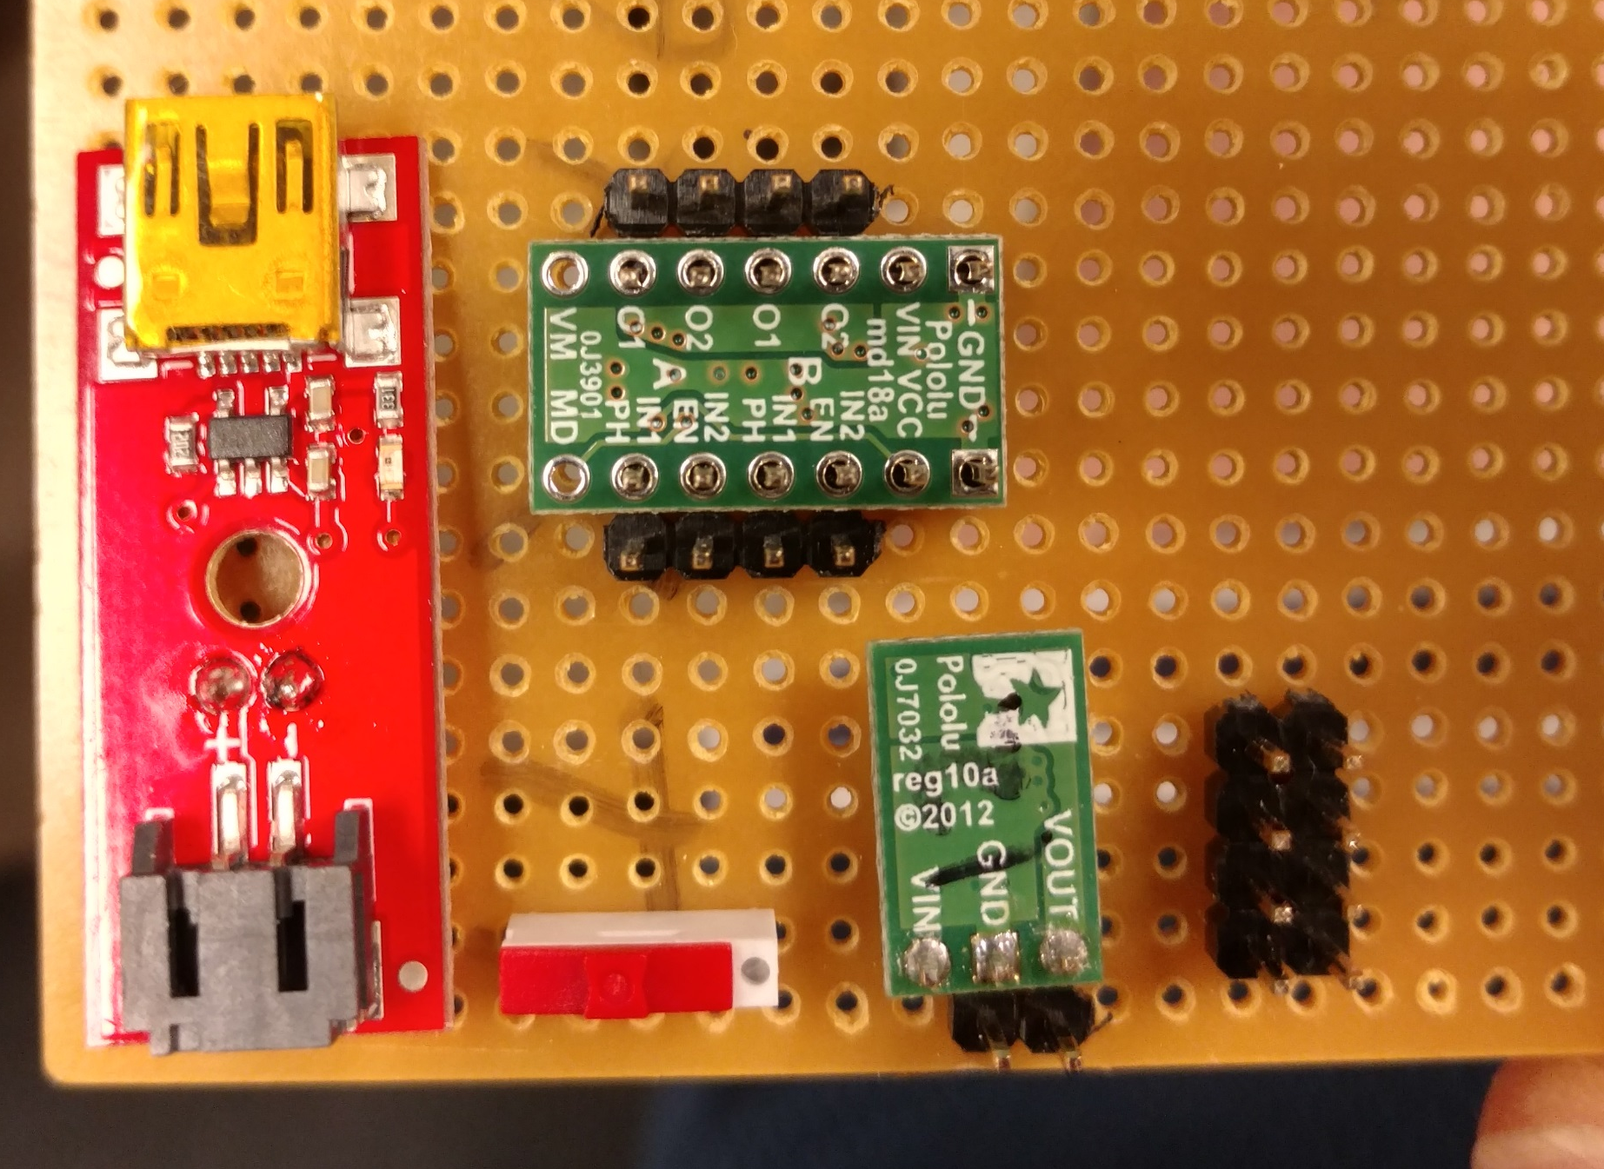
IR Sensor Hookup
Due GND
Due 5V+
Due Vin

Slide 9
Front of Robot
0
1
2
3
4
5
6
7
Back of Robot

